Slide 1

Continuing Use Cases

Slide 2
Fort Hill Steps

Slide 3
Fort Hill Steps

Slide 11
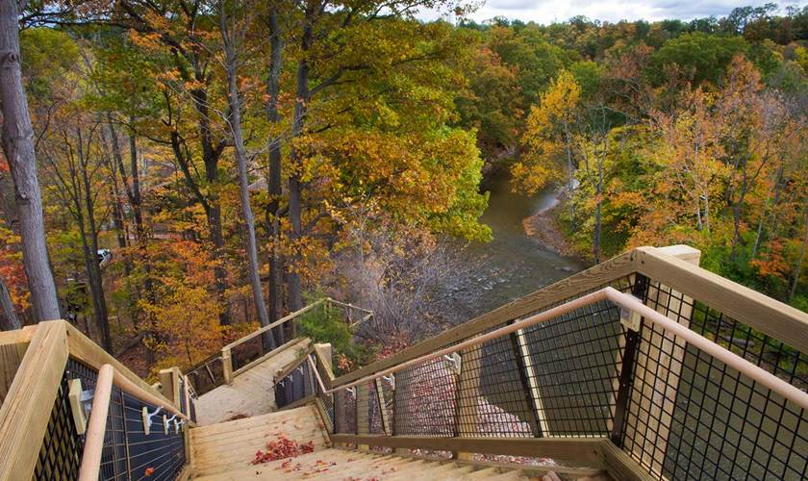

Slide 12
Zanzibar Mapping Initiative

Slide 13
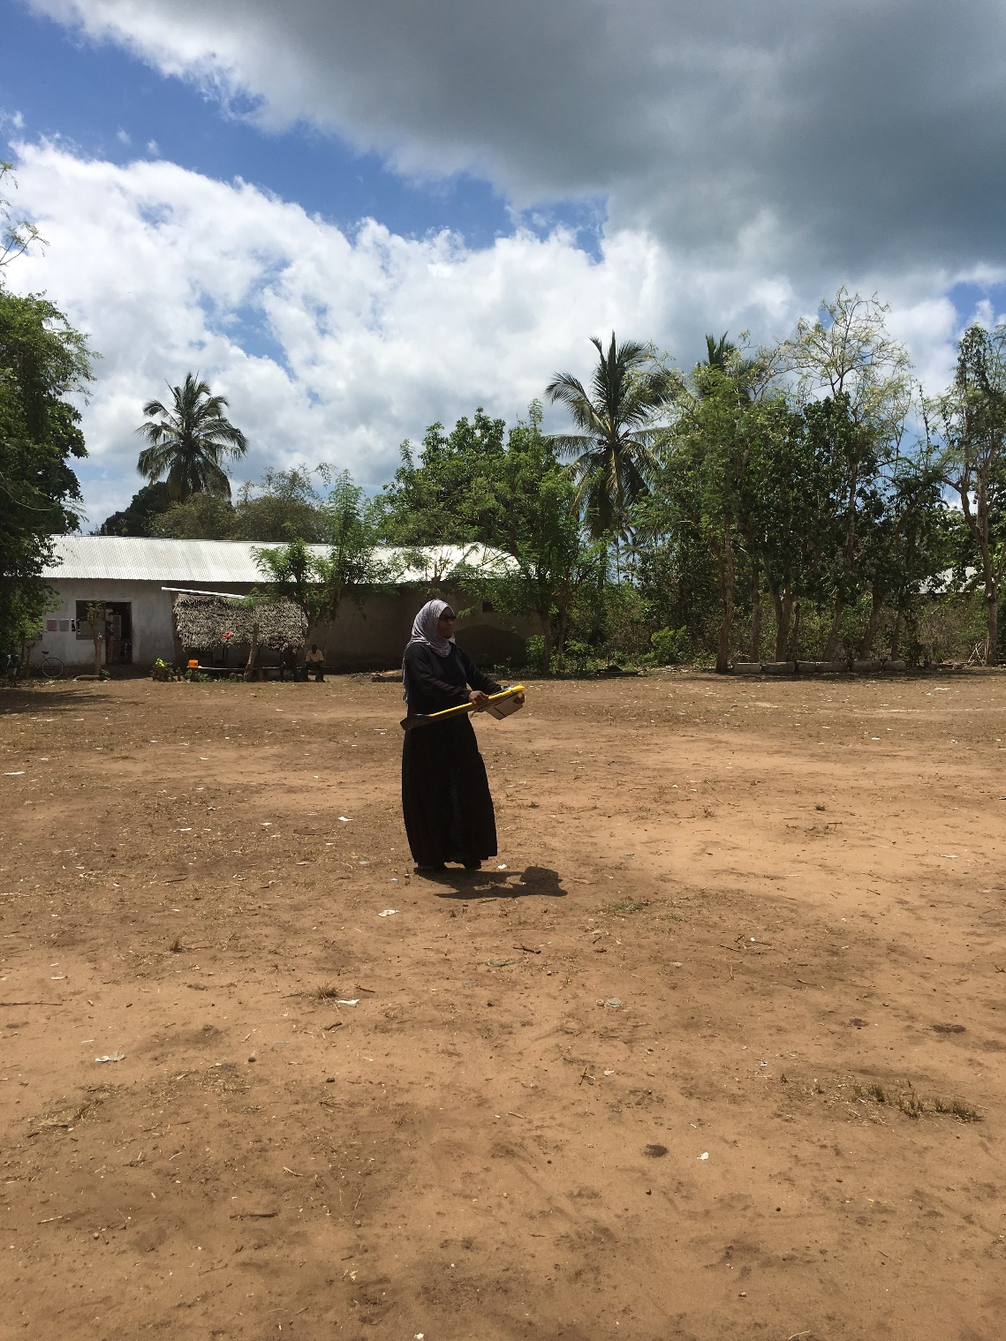
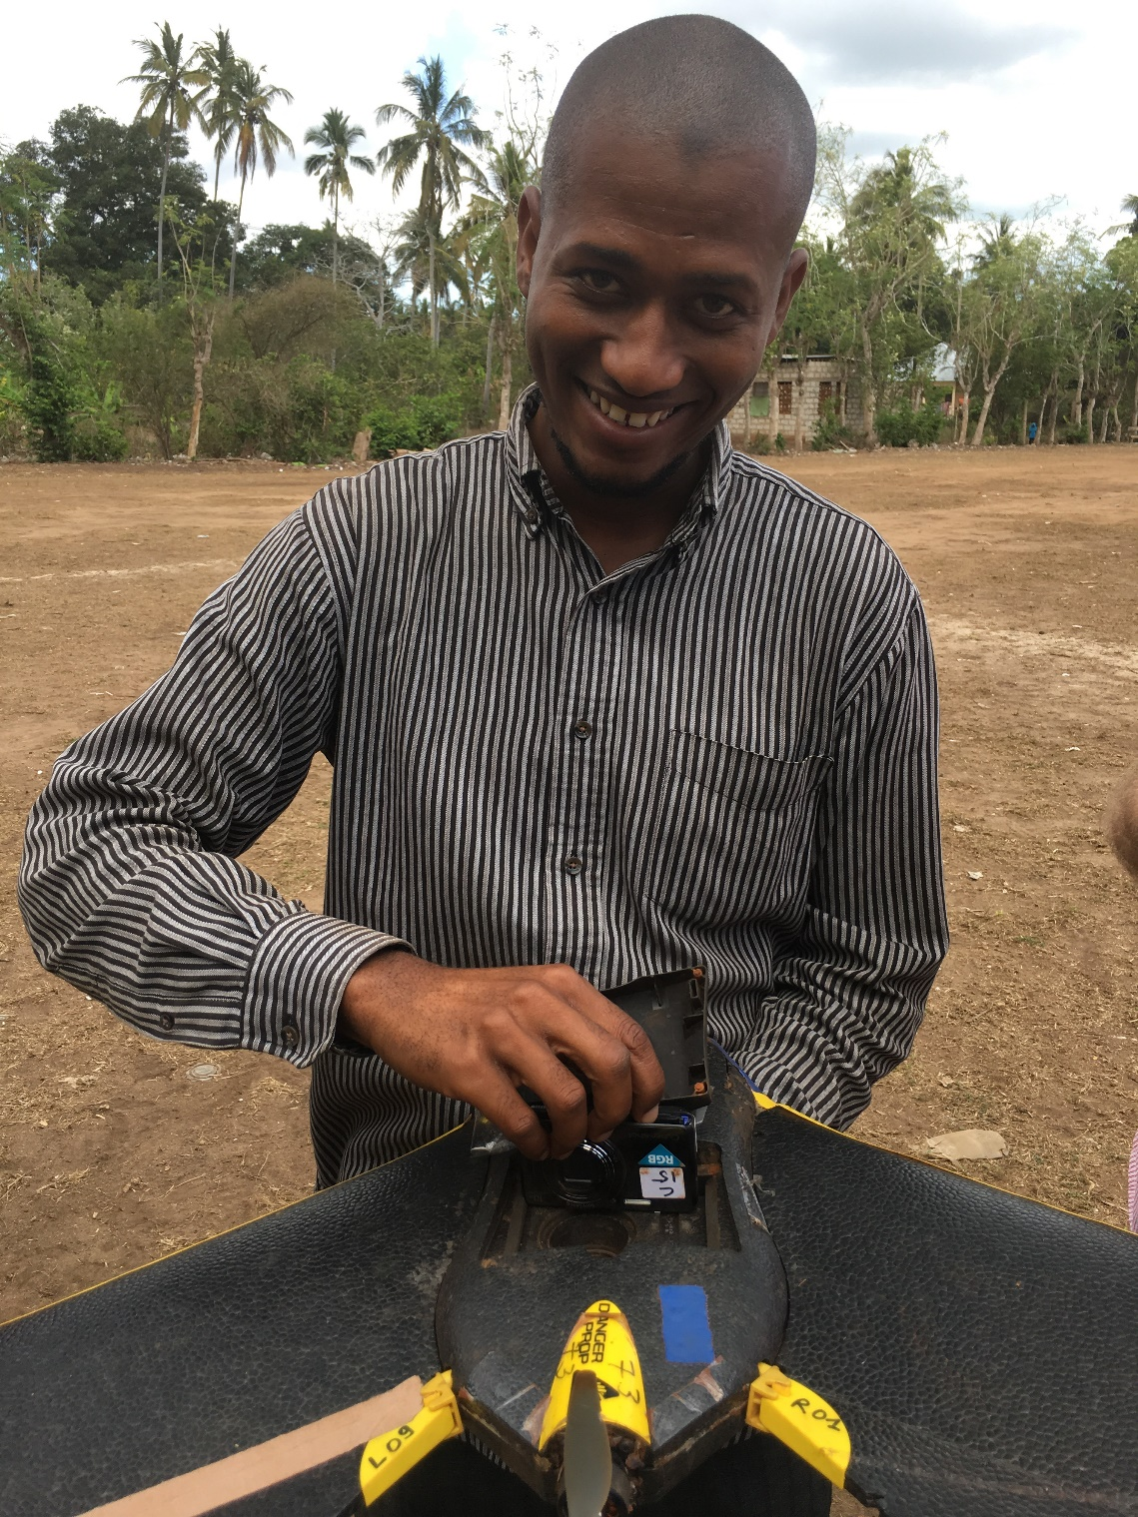

Slide 14
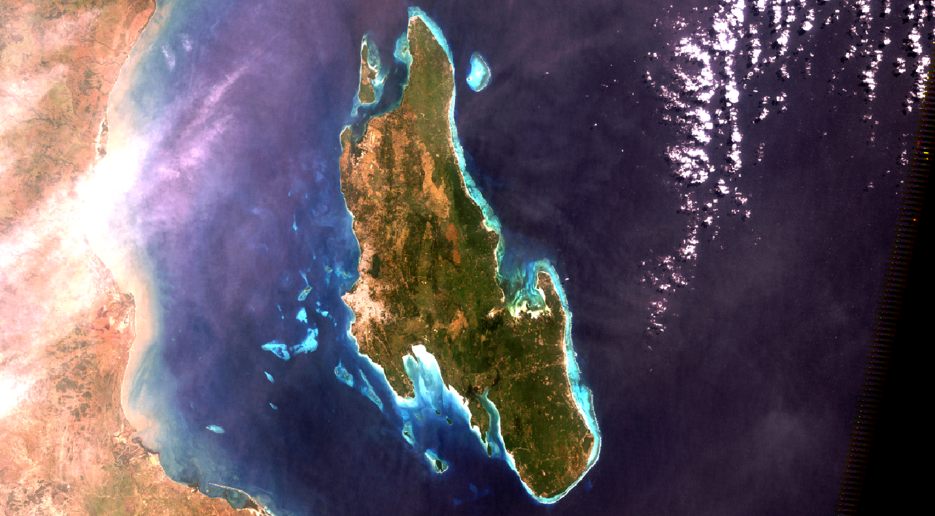

Slide 15
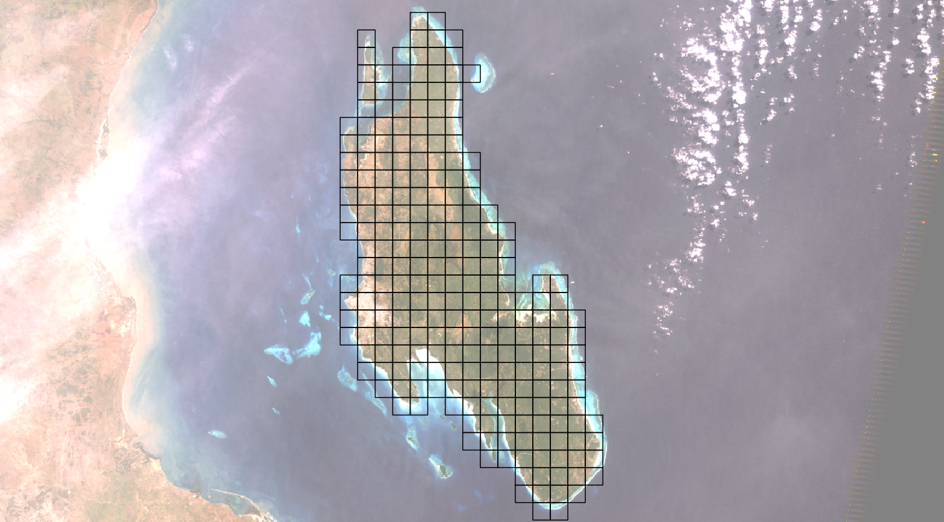

Slide 16
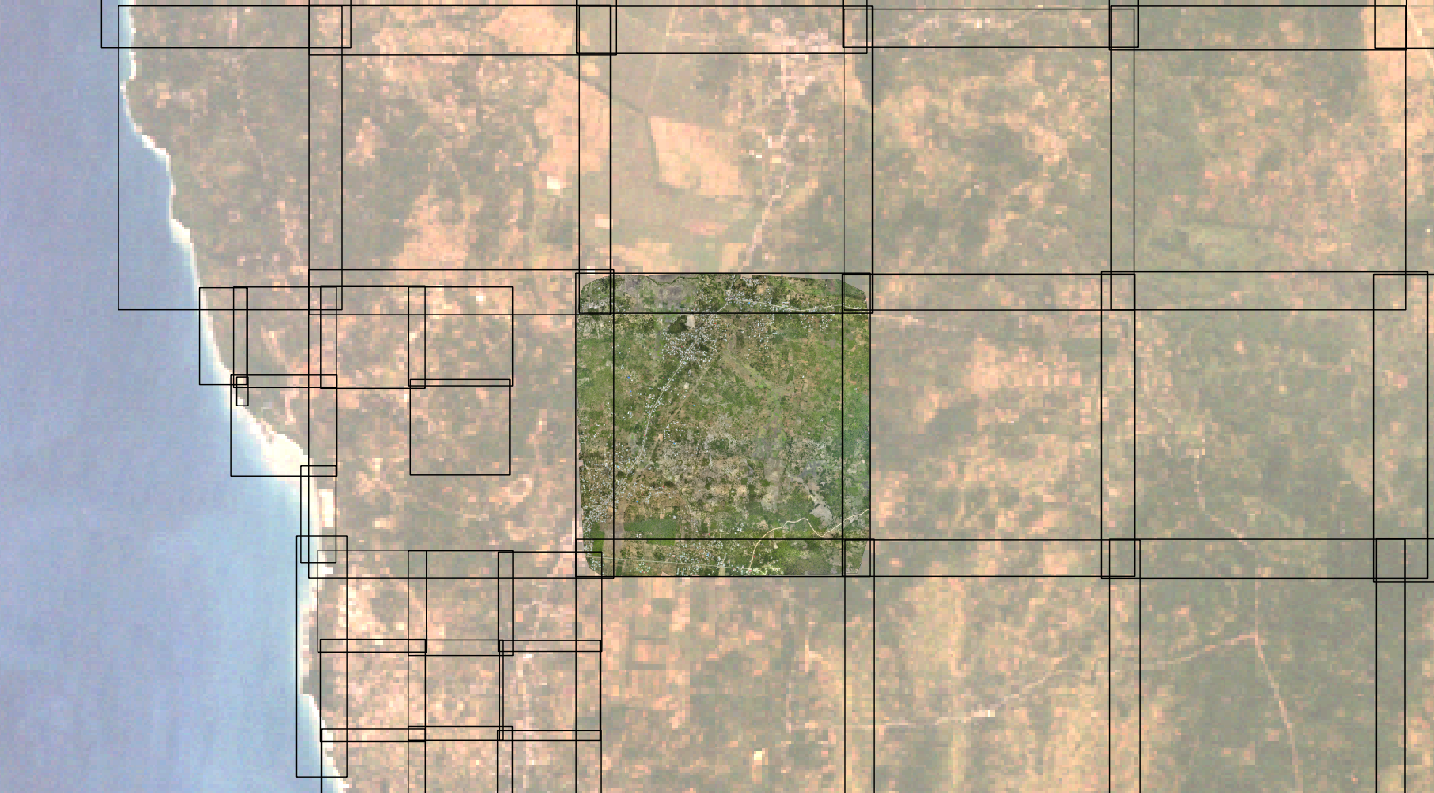

Slide 17
(Show in QGIS)

Slide 18
OpenDroneMap is an open source toolkit for aerial drone imagery.
It is modern photogrammetry - fully automated matching, digital surface modeling, and mosaicking

Slide 19
In preparation for the robot takeover.

Slide 20
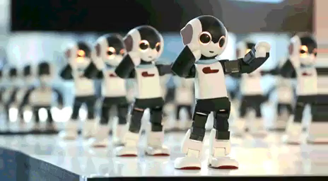
Preparation for the Robot Takeover
Why?
https://imgur.com/gallery/azyruE3

Slide 21
The Future

Slide 22
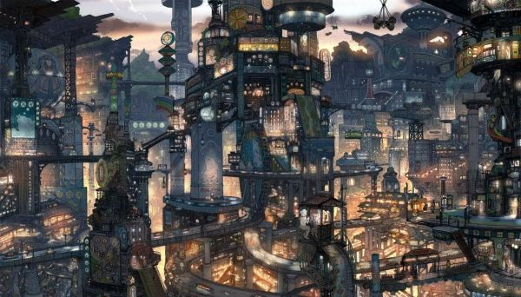
https://s-media-cache-ak0.pinimg.com/736x/61/f0/37/61f037cb982dbd3d9720a107e9373b01.jpg

Slide 23
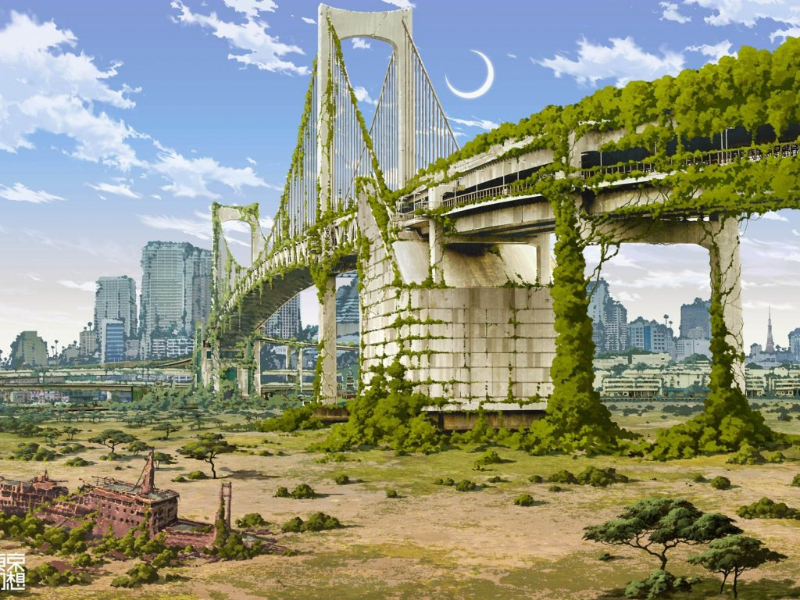
https://www.walldevil.com/6554-bridges-cities-crescent-moon-fantasy-futuristic-japan-landscapes-moss-nature-postapocalyptic-rainbow-bridge-ruins-ships-tokyo-tokyogenso-vehicles.html

Slide 24
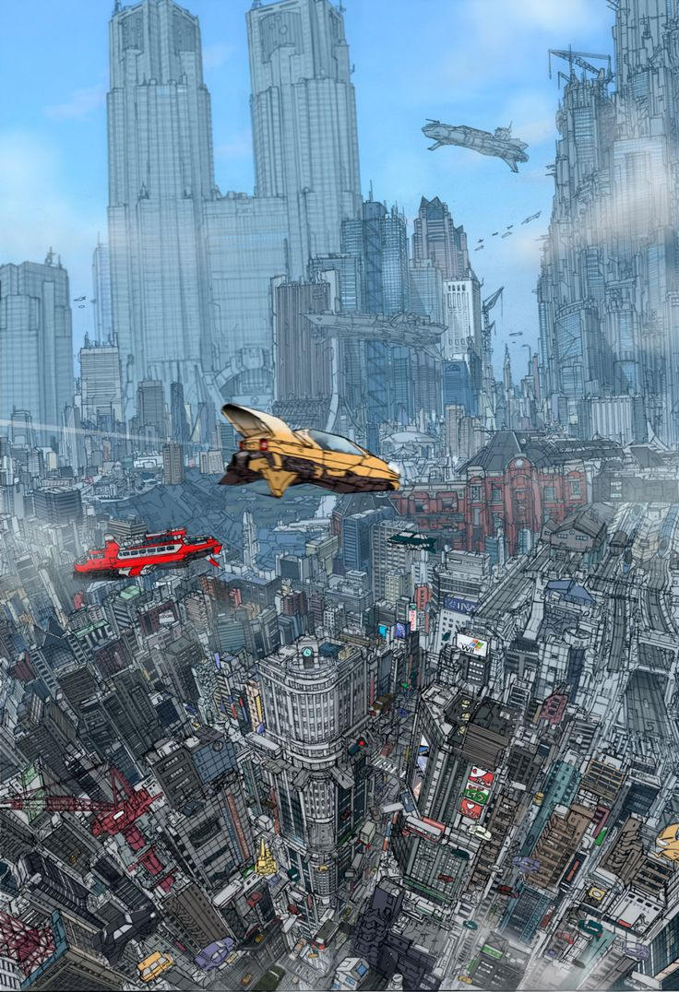
https://s-media-cache-ak0.pinimg.com/736x/36/a5/e7/36a5e797df79b8ed4931d40dc75c0084.jpg

Slide 25
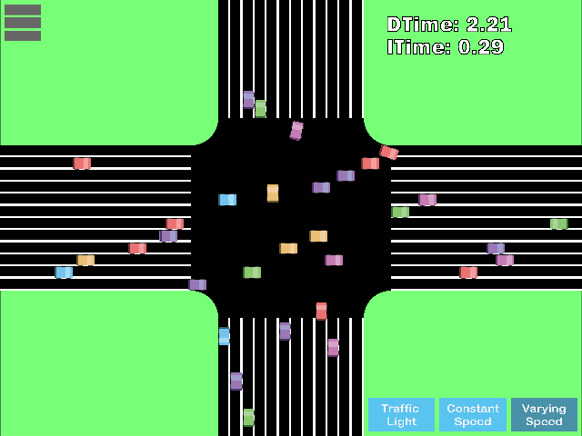

Slide 26
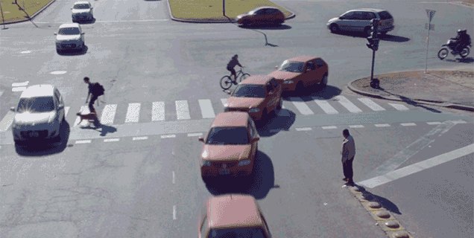

Slide 27
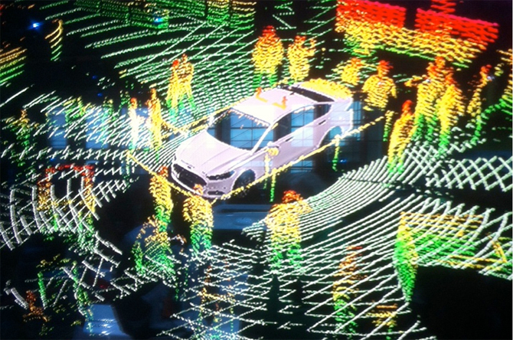

Slide 28
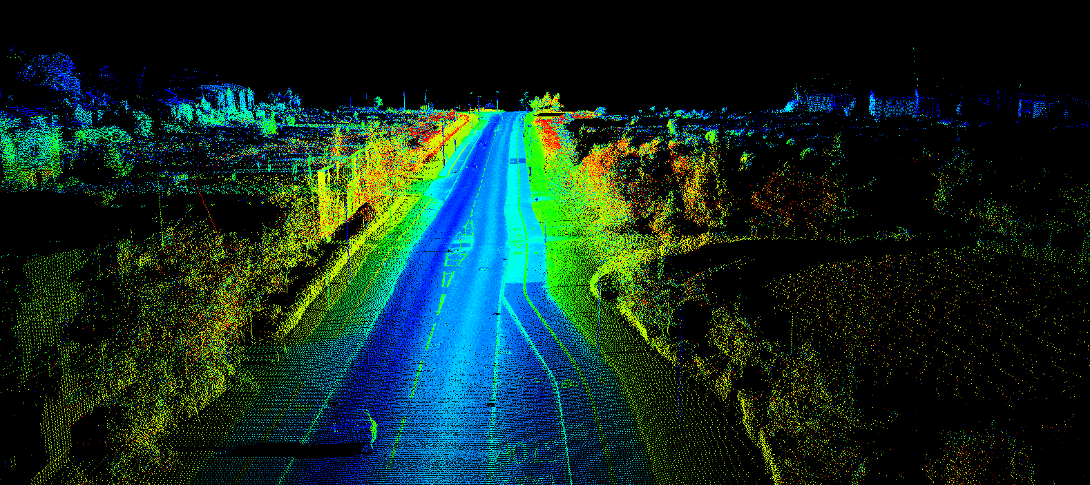
http://www.renishaw.com/media/img/gen/9a5511617ef7479a8d3ddc0917dc5b6d.png

Slide 29
OpenDroneMap is an open source toolkit for aerial drone imagery.
It is modern photogrammetry - fully automated matching, digital surface modelling, and mosaicking
Platform vs. Toolkit

Slide 30
Platform vs. Toolkit
(but it can be a platform – someone else could manage it for you)
OpenDroneMap is an open source toolkit for aerial drone imagery.
It is modern photogrammetry - fully automated matching, digital surface modelling, and mosaicking

Slide 31
Origins
Computer Vision
Photogrammetry
Notes:
OpenDroneMap originates from Computer Vision, i.e. how do we enable computers to navigate and understand the world.
It depends on stereo vision much like we do to make sense of the world in 3D

Slide 32
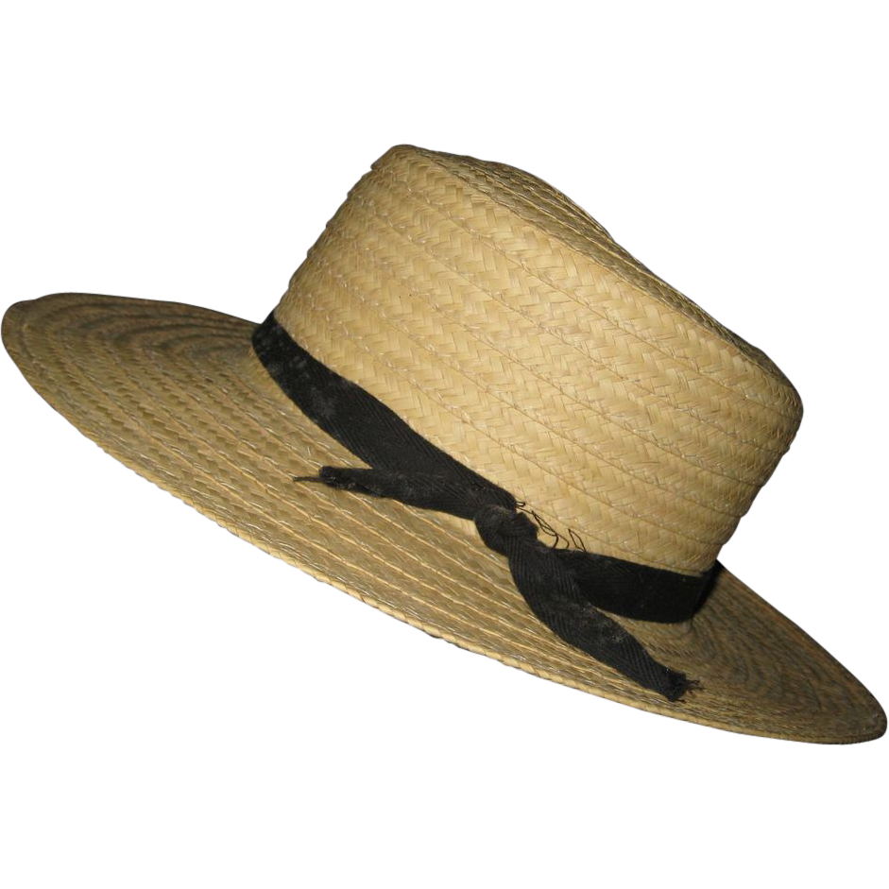
Purposes
Ecology
Humanitarian
Participatory creation of data for the public good
http://image0-rubylane.s3.amazonaws.com/shops/suzanstreasures/VCx20-x201402.1L.jpg
Notes:
OpenDroneMap originates from Computer Vision, i.e. how do we enable computers to navigate and understand the world.
It depends on stereo vision much like we do to make sense of the world in 3D

Slide 33
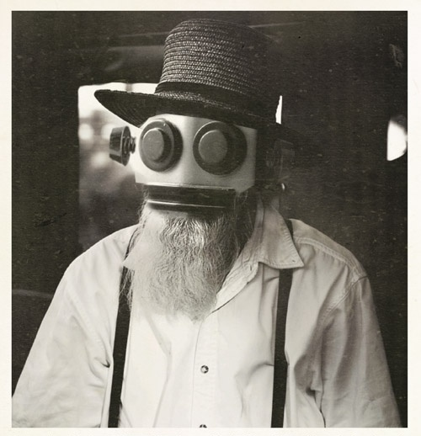
This complicates my robot narrative…
https://s-media-cache-ak0.pinimg.com/736x/a7/9a/73/a79a731eea0f09d09c012856914e74dc.jpg

Slide 34
Some hard problems of photogrammetry
Making measurements from photographs
Camera (Aircraft) Position
Camera (Aircraft) Orientation (pitch, roll, yaw)
Lens Distortion
Relief Displacement

Slide 35
Some hard problems of photogrammetry
Making measurements from photographs
Camera (Aircraft) Position
Camera (Aircraft) Orientation (pitch, roll, yaw)
Lens Distortion
Relief Displacement

Slide 36
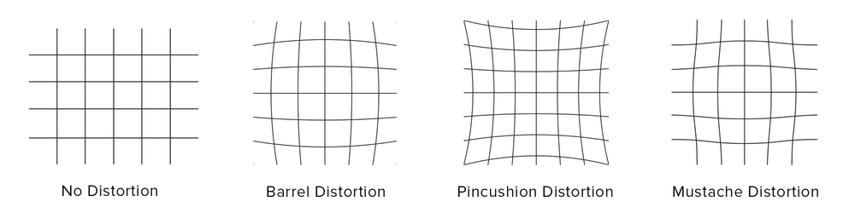
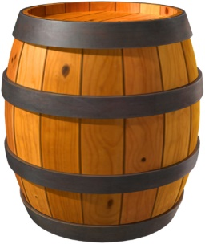
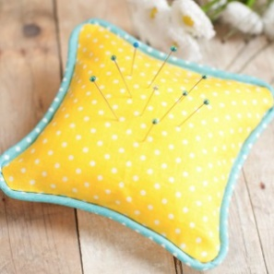

Lens Distortion Types (an incomplete list)
http://www.drewgrayphoto.com/learn/distortion101
Pincushion
Barrel
Mustache

Slide 37
Lens Distortion Types (an incomplete list)
Pincushion
Mustache
Barrel

Slide 38
Lens Distortion Types (an incomplete list)
Barrel
Pincushion
Mustache

Slide 39
Lens Distortion Types (an incomplete list)
Barrel
Pincushion
Mustache

Slide 40
Lens Distortion Types (an incomplete list)
Barrel
Pincushion
Mustache

Slide 41
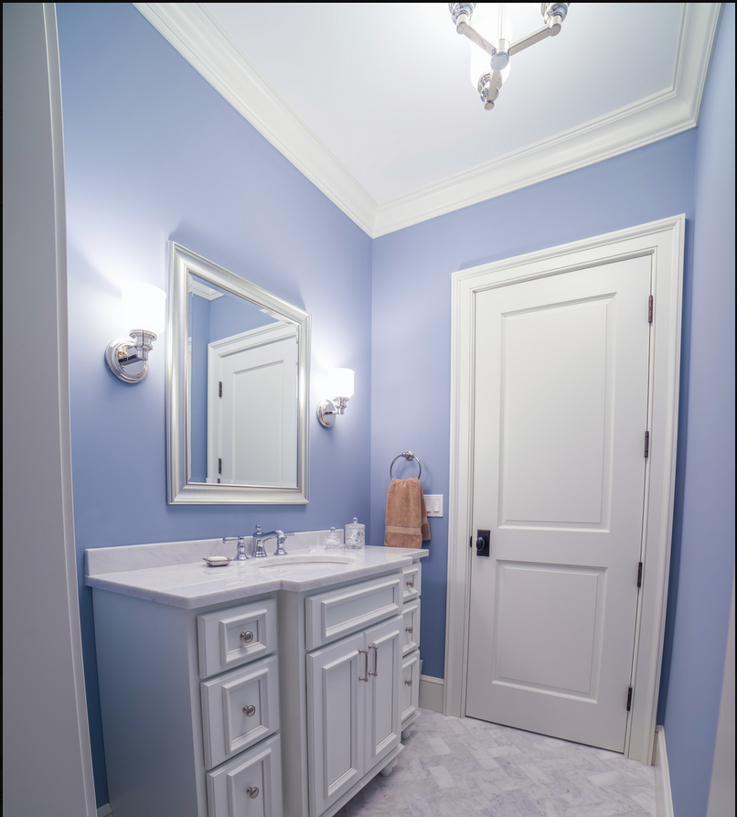
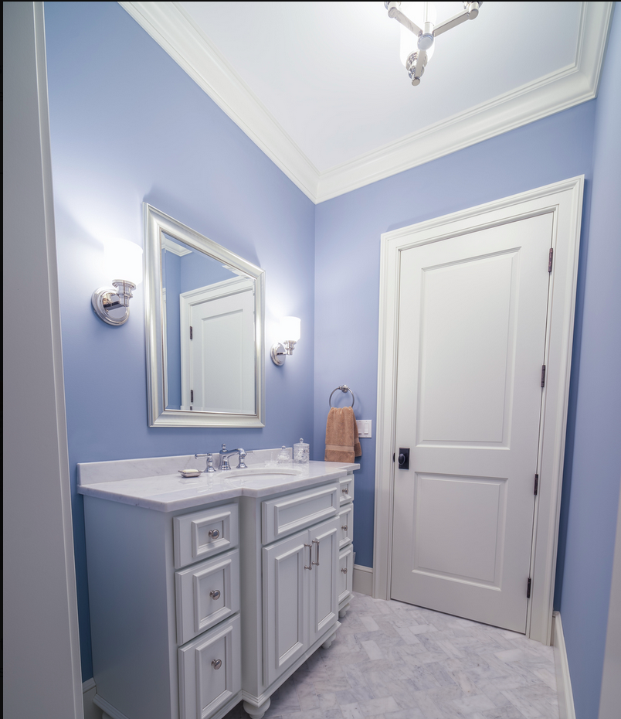
Lens Correction in Photoshop

Slide 42
Lens Correction in Photoshop

Slide 43
Lens distortion with 3D Landscape Data

Slide 44
Lens distortion with 3D Landscape Data

Slide 45
Lens distortion with 3D Landscape Data

Slide 46
Lens distortion with 3D Landscape Data

Slide 47
Lens distortion with 3D Landscape

Slide 48
Lens distortion with 3D Landscape

Slide 49
Solution

Slide 50
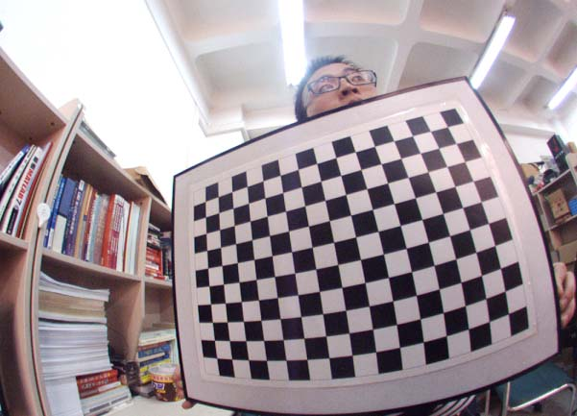
Checkerboard
http://swardtoolbox.github.io/

Slide 51
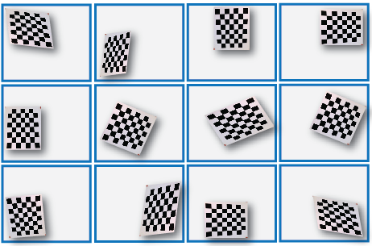
Checkerboard
https://nl.mathworks.com/help/vision/ug/single-camera-calibrator-app.html

Slide 52
Some hard problems of photogrammetry
Making measurements from photographs
Camera (Aircraft) Position
Camera (Aircraft) Orientation (pitch, roll, yaw)
Lens Distortion
Relief Displacement

Slide 53
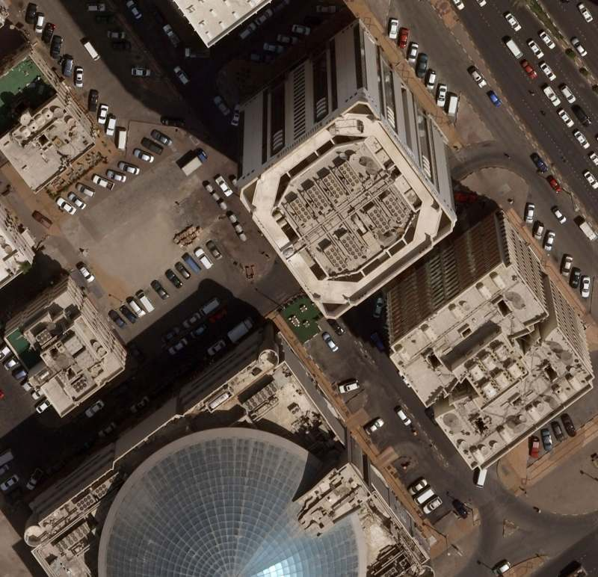
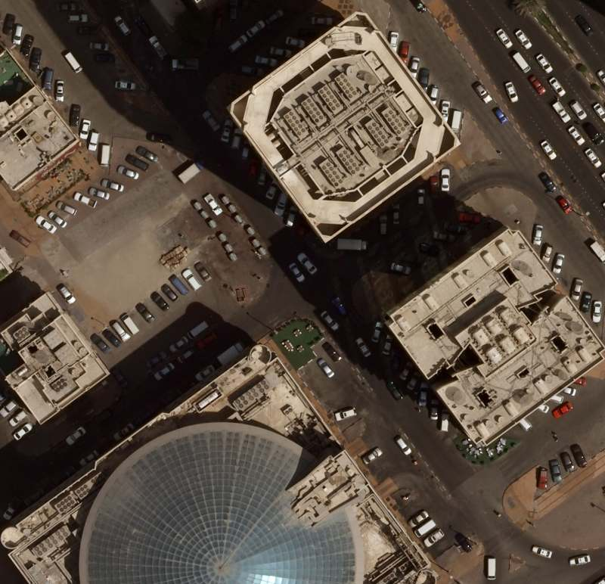
Relief Displacement
http://surveying.structural-analyser.com/chapter09/

Slide 54
Correcting for Relief Displacement
We need a good Digital Surface Model

Slide 55
Some hard problems of photogrammetry
Making measurements from photographs
Camera (Aircraft) Position
Camera (Aircraft) Orientation (pitch, roll, yaw)
Lens Distortion
Relief Displacement

Slide 56
Some hard problems of photogrammetry
Making measurements from photographs
Camera (Aircraft) Position
Camera (Aircraft) Orientation (pitch, roll, yaw)
Lens Distortion
Relief Displacement

Slide 57
Camera Position
We solve with GPS + “Structure from Motion”

Slide 58
Camera Orientation
We solve with “Structure from Motion”

Slide 59
ODM and the photogrammetric process
Structure from Motion
Point Cloud Densification
Surface Reconstruction
Multi-View Stereo Texturing
Orthophoto Generation

Slide 60
ODM and the photogrammetric process
Structure from Motion
Point Cloud Densification
Poisson Surface Reconstruction
Multi-View Stereo Texturing
Orthophoto Generation

Slide 61
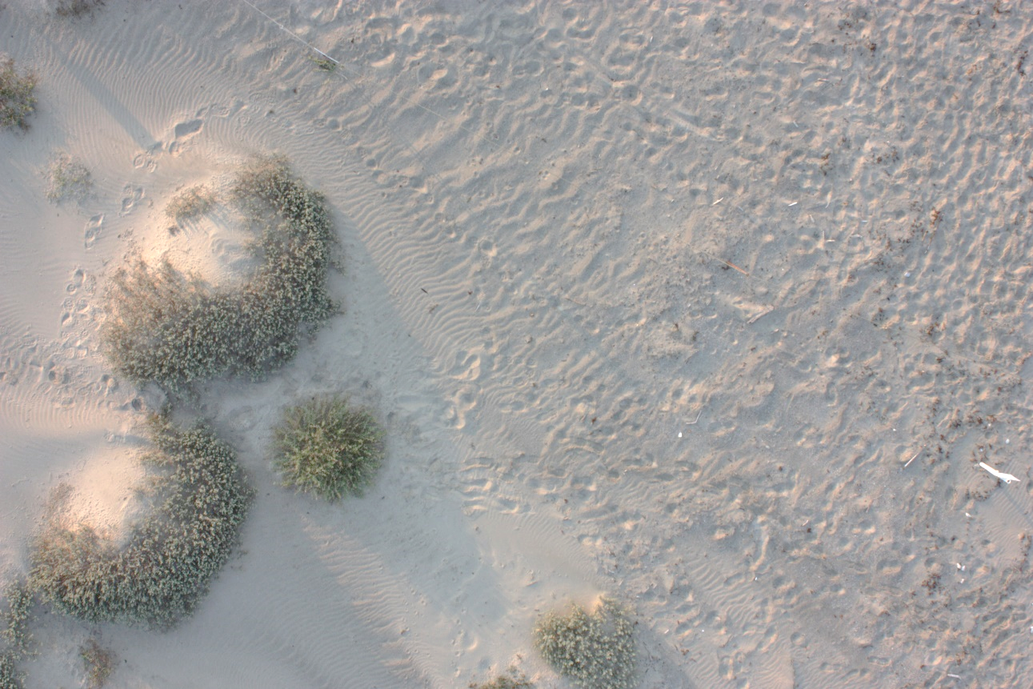
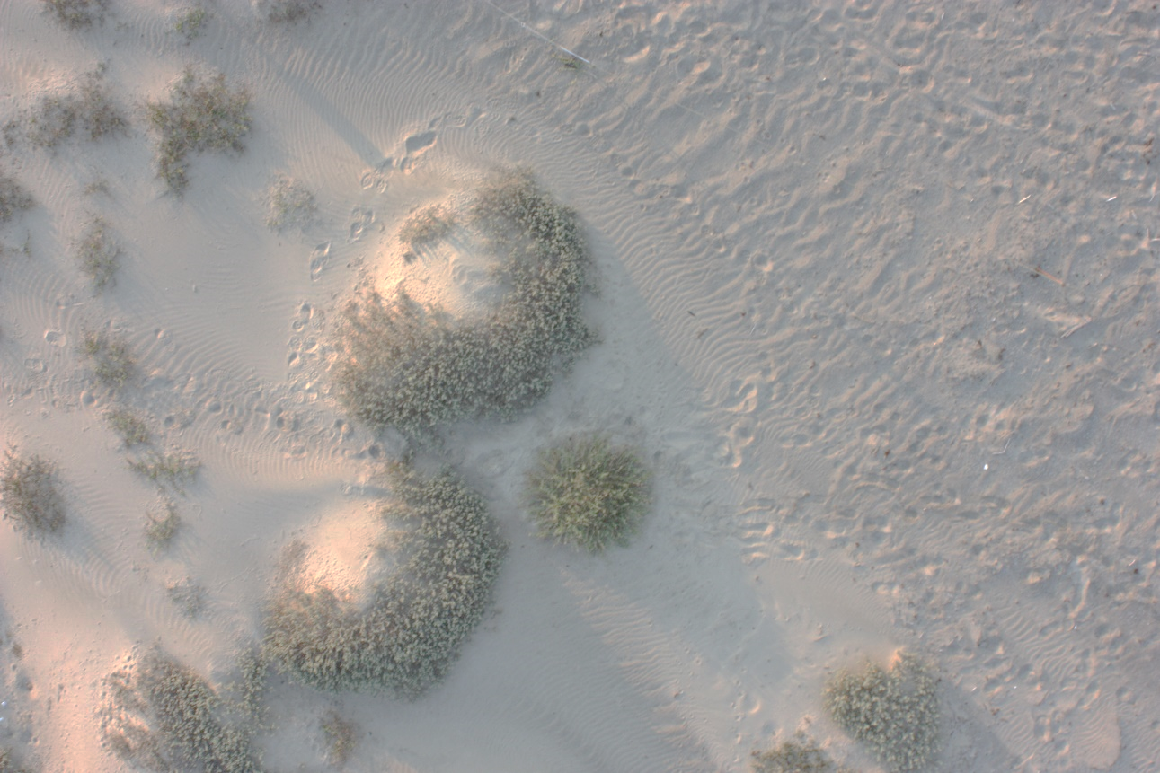
Structure from Motion
Matches features extracted from images with overlap
Credit: Michelle Tobias

Slide 62
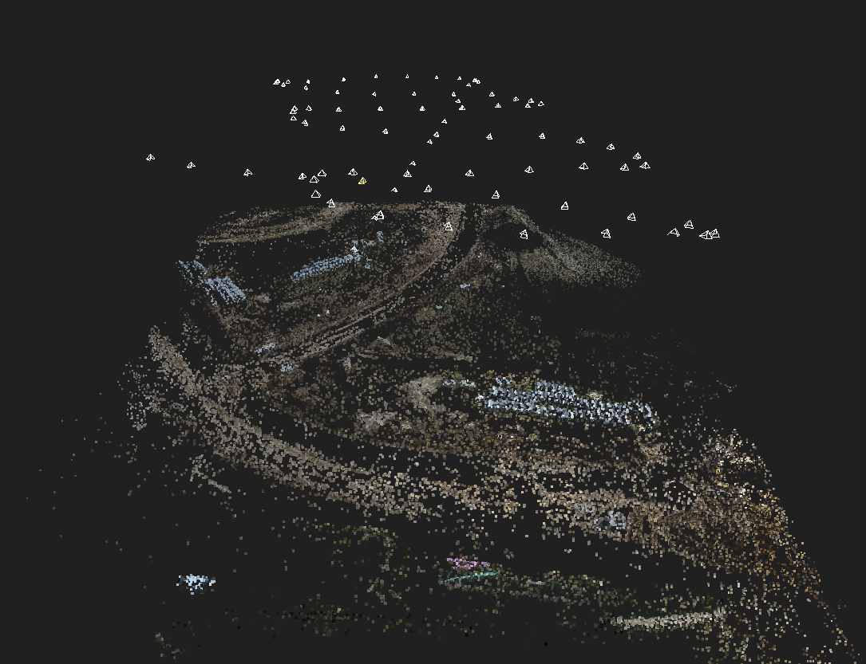
https://geokota.wordpress.com/

Slide 63
Photogrammetry Process
Structure from Motion
Point Cloud Densification
Surface Reconstruction
Multi-View Stereo Texturing
Orthophoto Generation

Slide 64
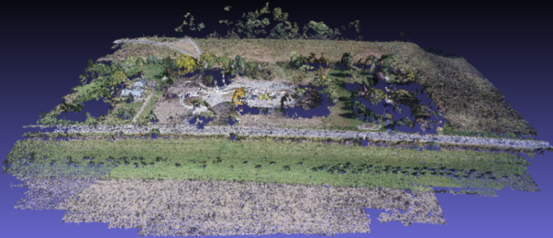
Point Cloud from Matching
Notes:
(Photogrammetrically Derived Point Cloud)

Slide 65
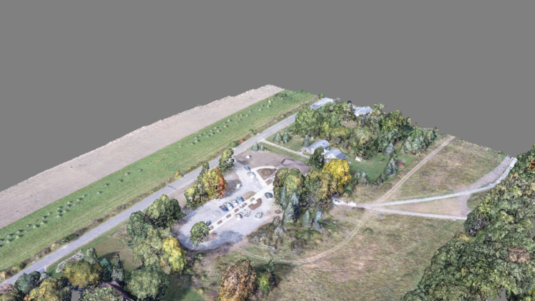
Dense Point Cloud from finding all matches

Slide 66
Photogrammetry Process
Structure from Motion
Point Cloud Densification
Surface Reconstruction
Multi-View Stereo Texturing
Orthophoto Generation

Slide 67
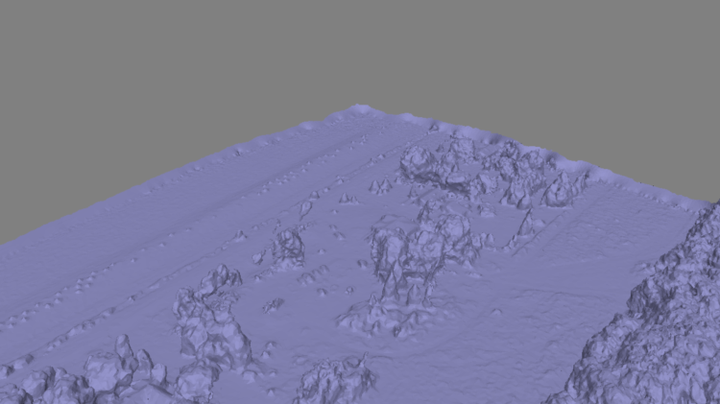
Mesh
Notes:
Uses the Point Cloud Library (PCL), followed by mesh decimation

Slide 68
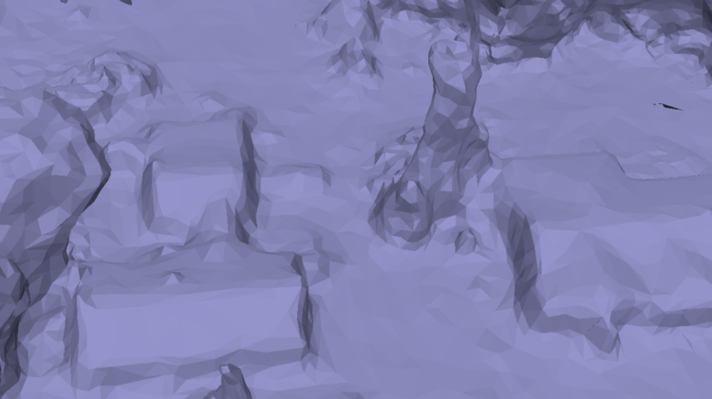
Mesh
Notes:
Uses the Point Cloud Library (PCL), followed by mesh decimation

Slide 69
Photogrammetry Process
Structure from Motion
Point Cloud Densification
Surface Reconstruction
Multi-View Stereo Texturing
Orthophoto Generation

Slide 70
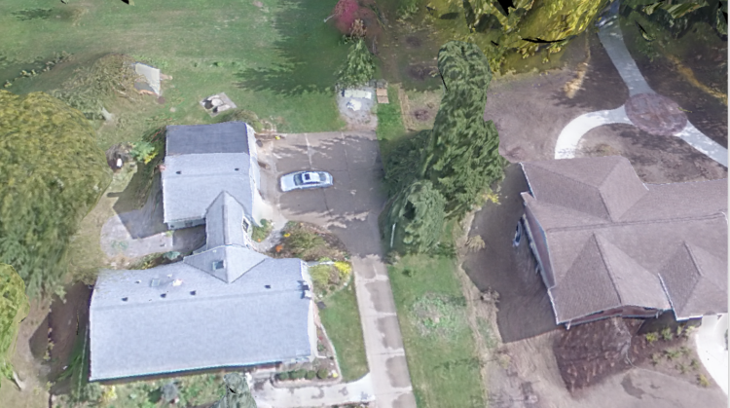
Texturing

Slide 71
Photogrammetry Process
Structure from Motion
Point Cloud Densification
Surface Reconstruction
Multi-View Stereo Texturing
Orthophoto Generation

Slide 72
Correcting for Relief Displacement
We need a good Digital Surface Model

Slide 74
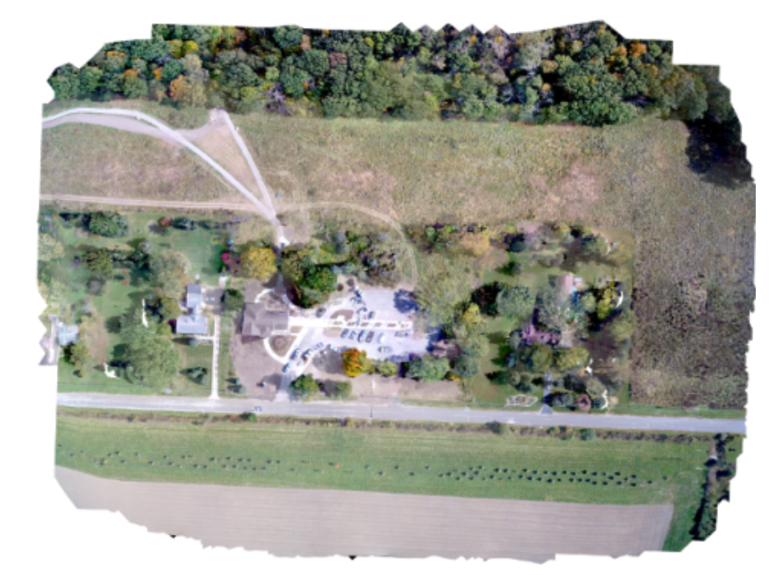
Orthophoto Generation

Slide 75
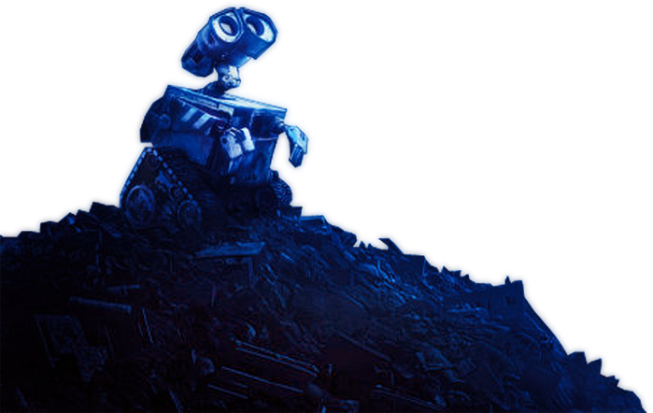
Questions you may be asking:
This is great, Steve. How do I get started in collecting the necessary datasets for the robot takeover?
https://photoshopstar.com/graphics/wall-e-cartoon-style-wallpaper/

Slide 76
How to Use OpenDroneMap

Slide 77
Installation
There are many ways to install ODM:
Natively using Ubuntu 14.04 or later (or with Virtual Machine via vagrant)
Linux, MacOS or Windows, by installing Docker
Via the above methods but with a Web-based GUI called WebODM
See project: OpenDroneMap.org

Slide 78
Usage
API
API Docs: https://opendronemap.github.io/WebODM/
Command line tool
Portable OpenStreetMap (POSM)
WebODM

Slide 79
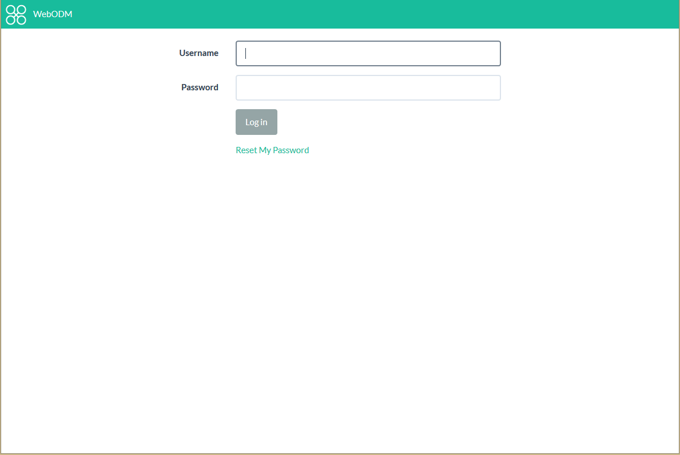

Slide 80
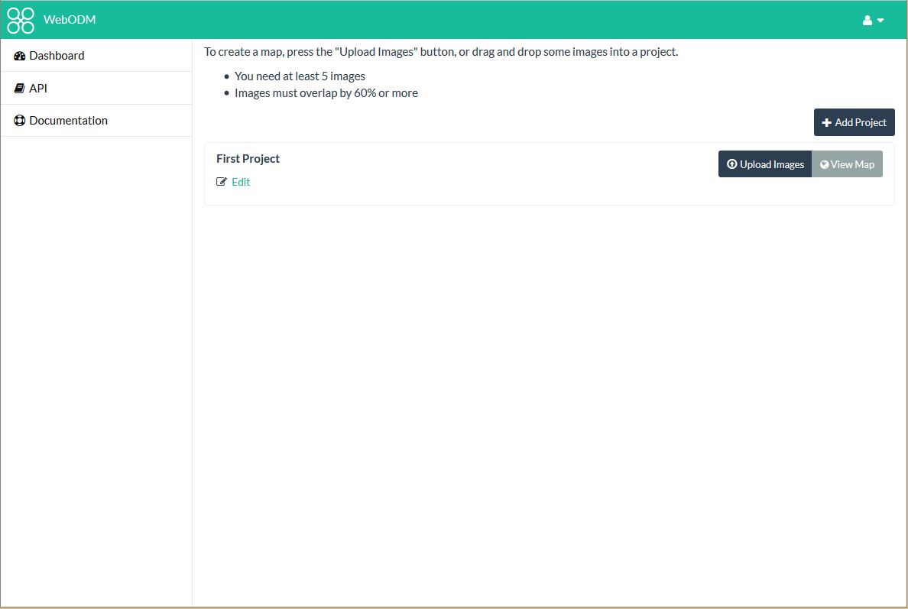

Slide 81
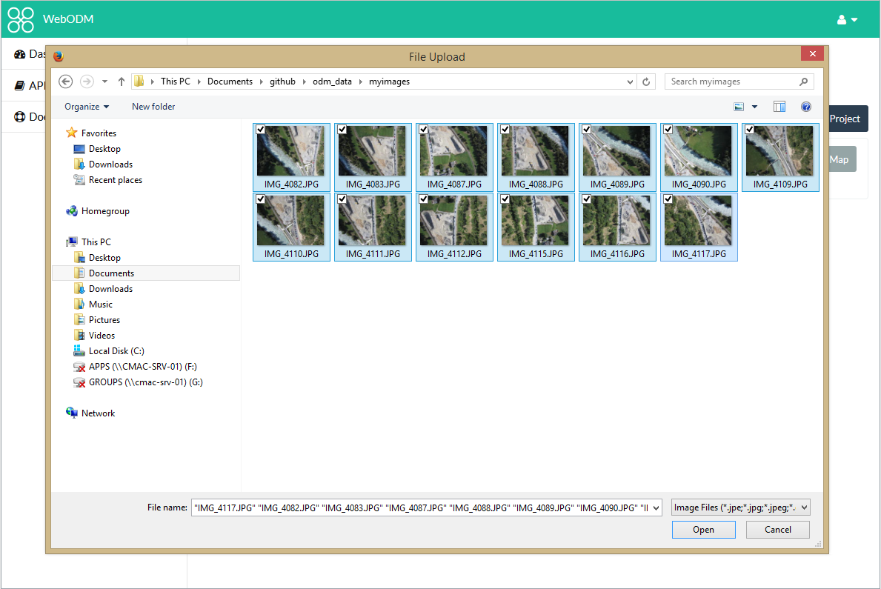

Slide 82
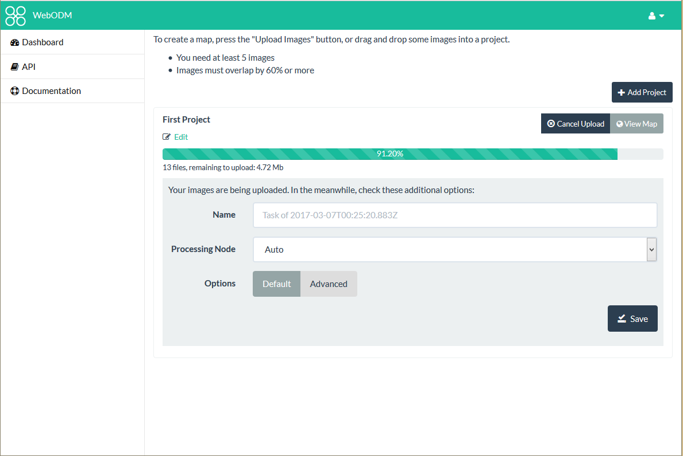

Slide 83
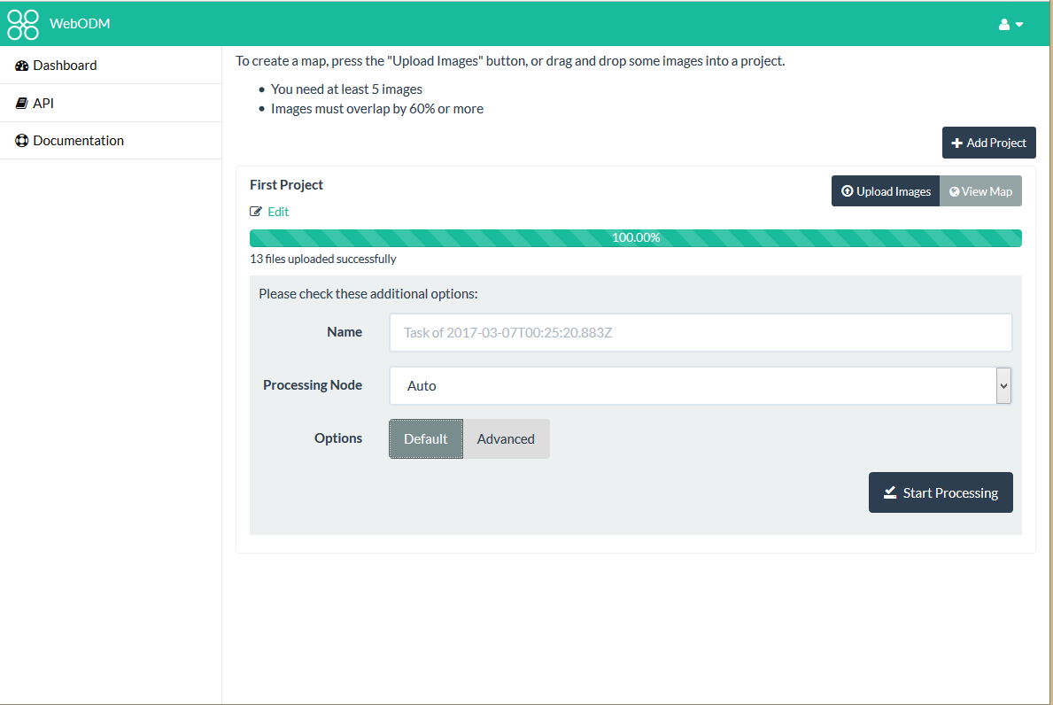

Slide 84
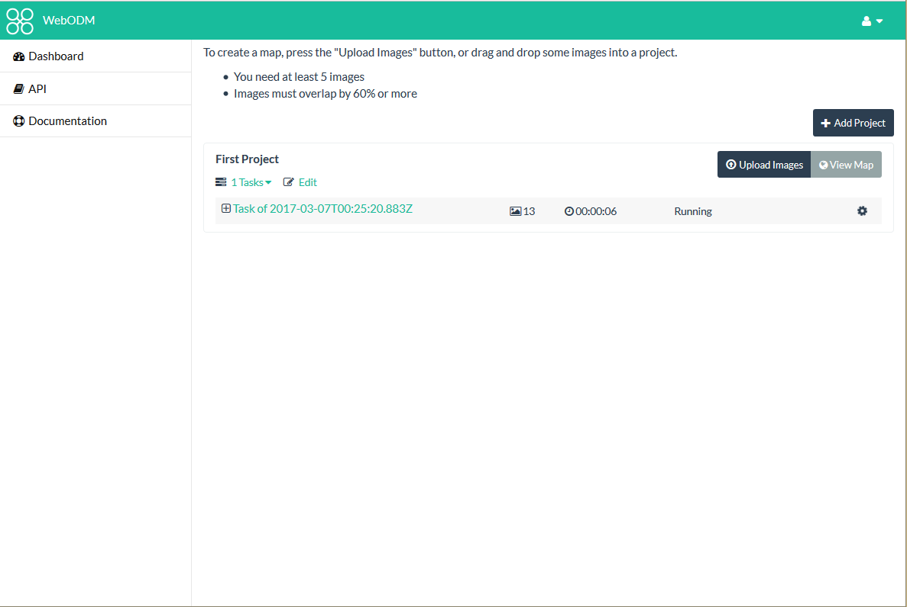

Slide 85
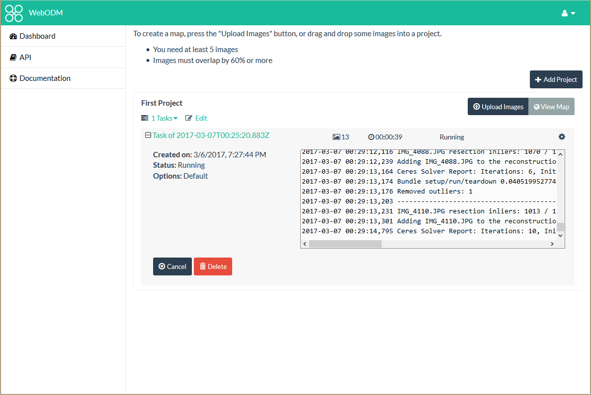

Slide 86
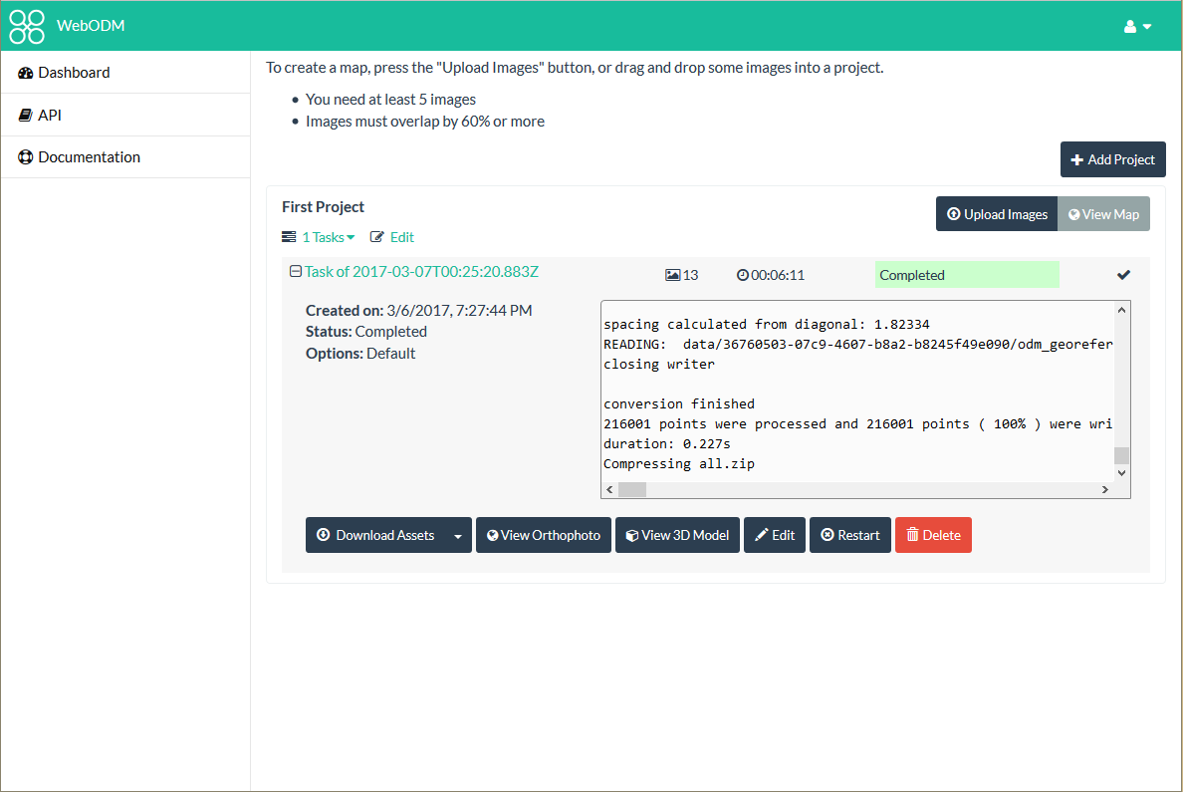

Slide 87
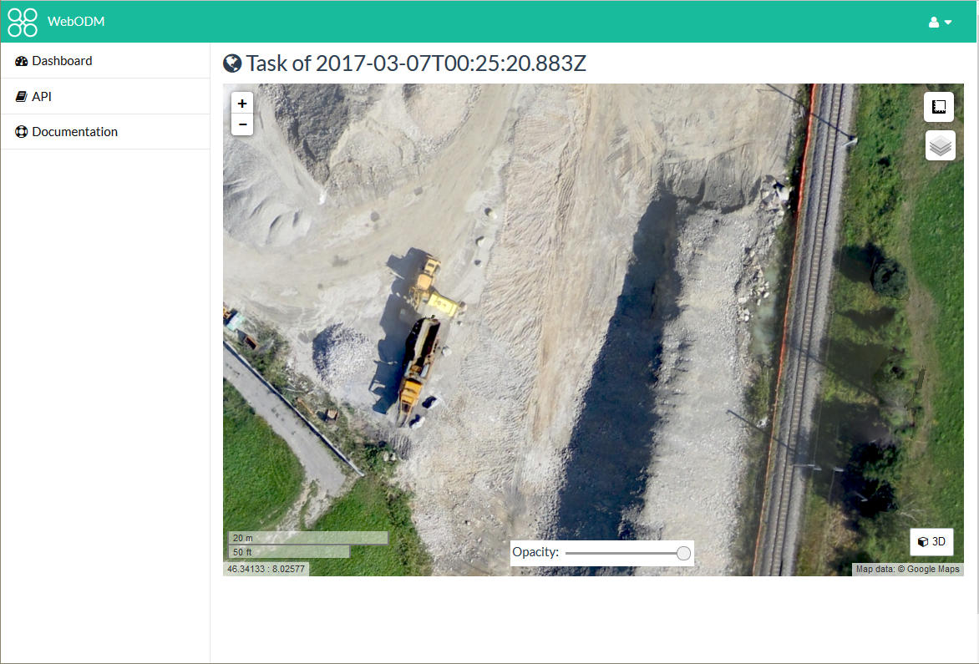

Slide 88
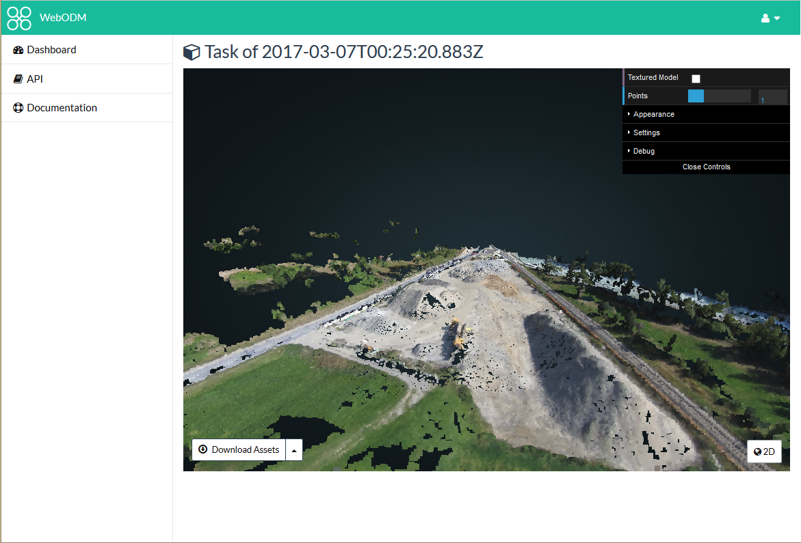

Slide 89
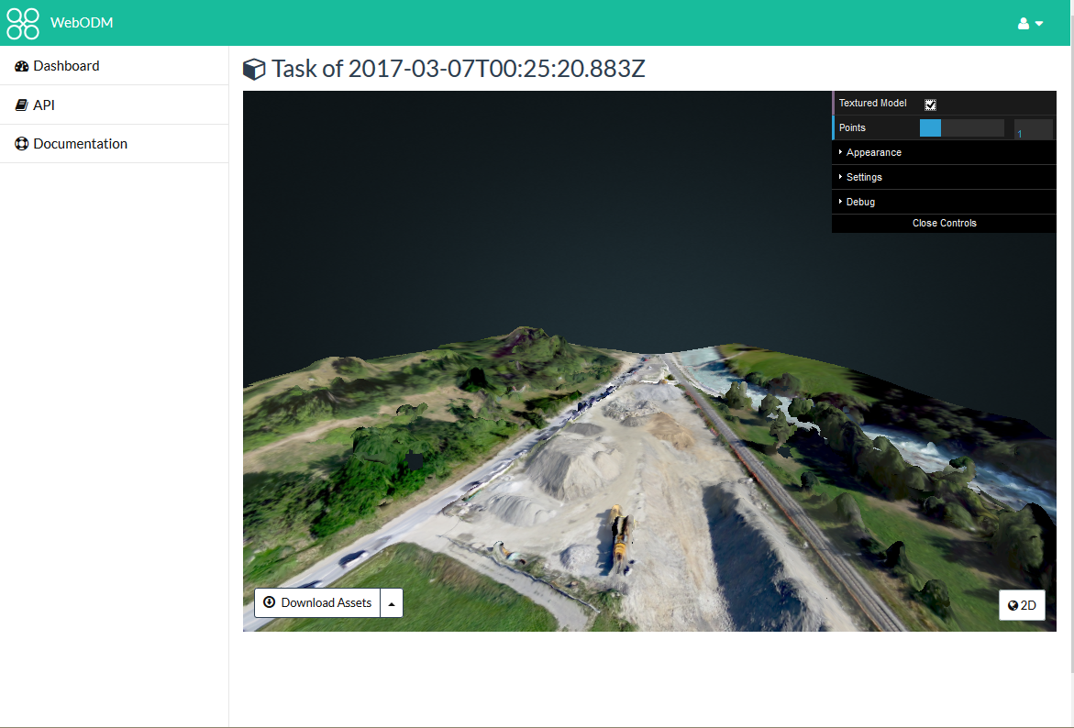

Slide 90
Funding and Future

Slide 91
Funding
Cleveland Metroparks
American Red Cross
Integration with Portable OpenStreetMap (POSM)
Humanitarian Innovation Fund
Make ODM Easier to Use
Make the products from it better / more accurate

Slide 92
OpenDroneMap: Future
Quality and robustness improvements
Scalability
Reduce memory footprint
Data Partitioning
Analysis
Add automated DTM extraction
Classification
Mesh improvements

Slide 93
DTM Extraction
Near future

Slide 94
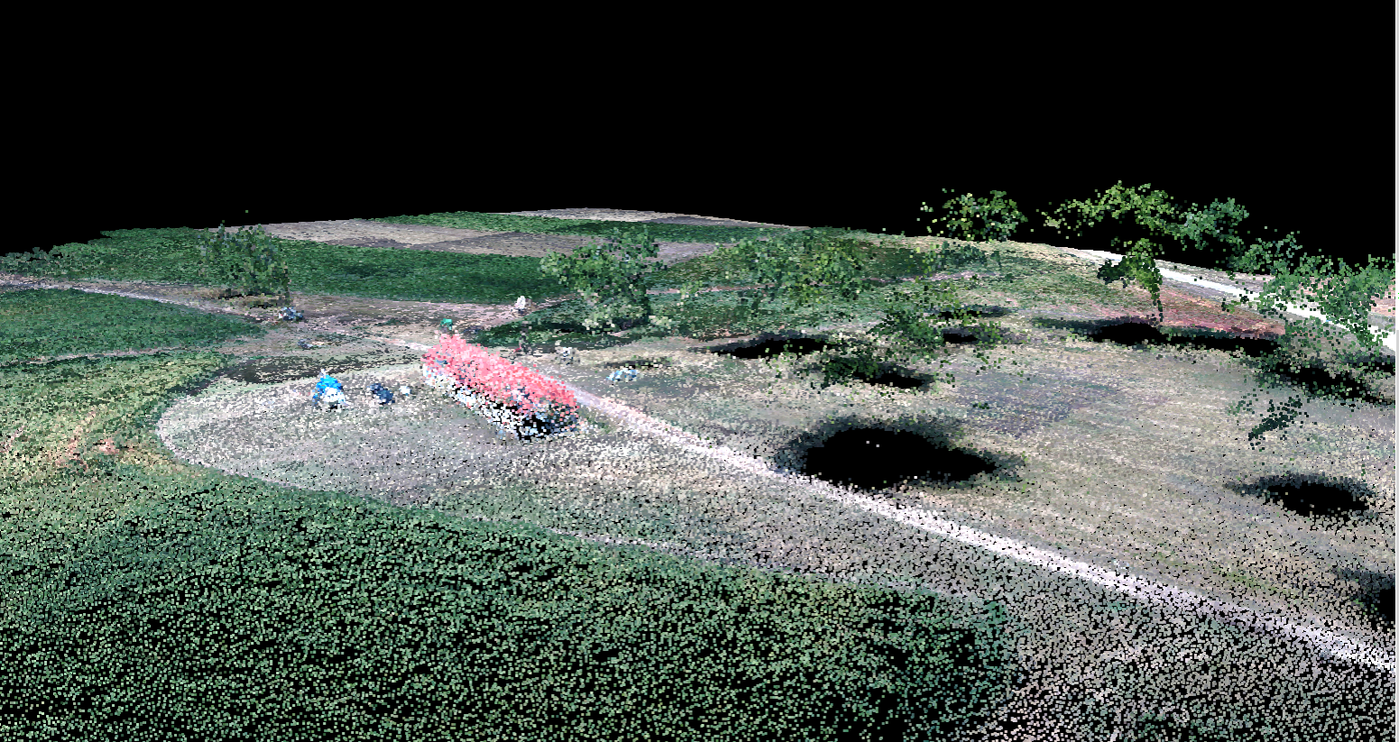
Midpines, flown by NextGen Air Transportation Center (NGAT) access to the data through collaboration with Center for Geospatial Analytics at NCSU

Slide 95
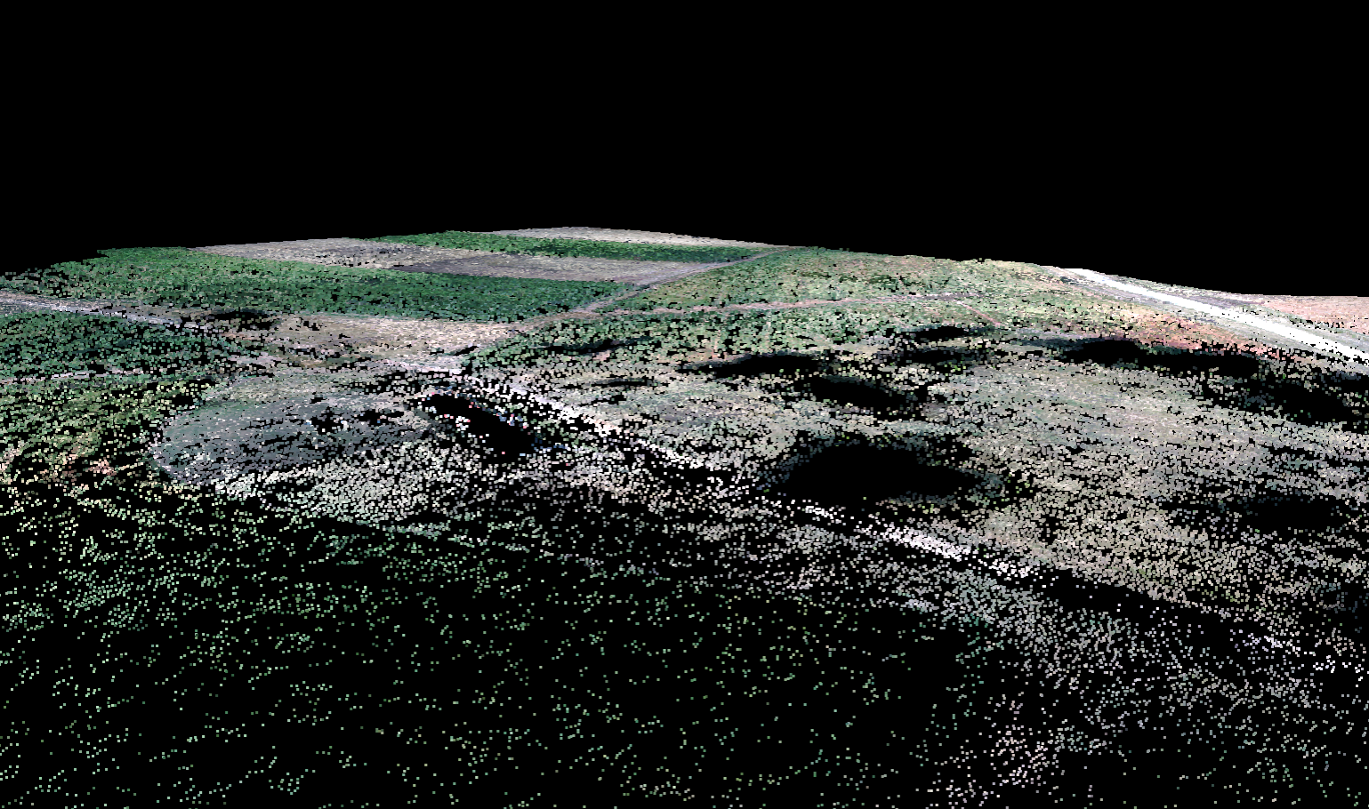
Midpines, flown by NextGen Air Transportation Center (NGAT) access to the data through collaboration with Center for Geospatial Analytics at NCSU

Slide 96
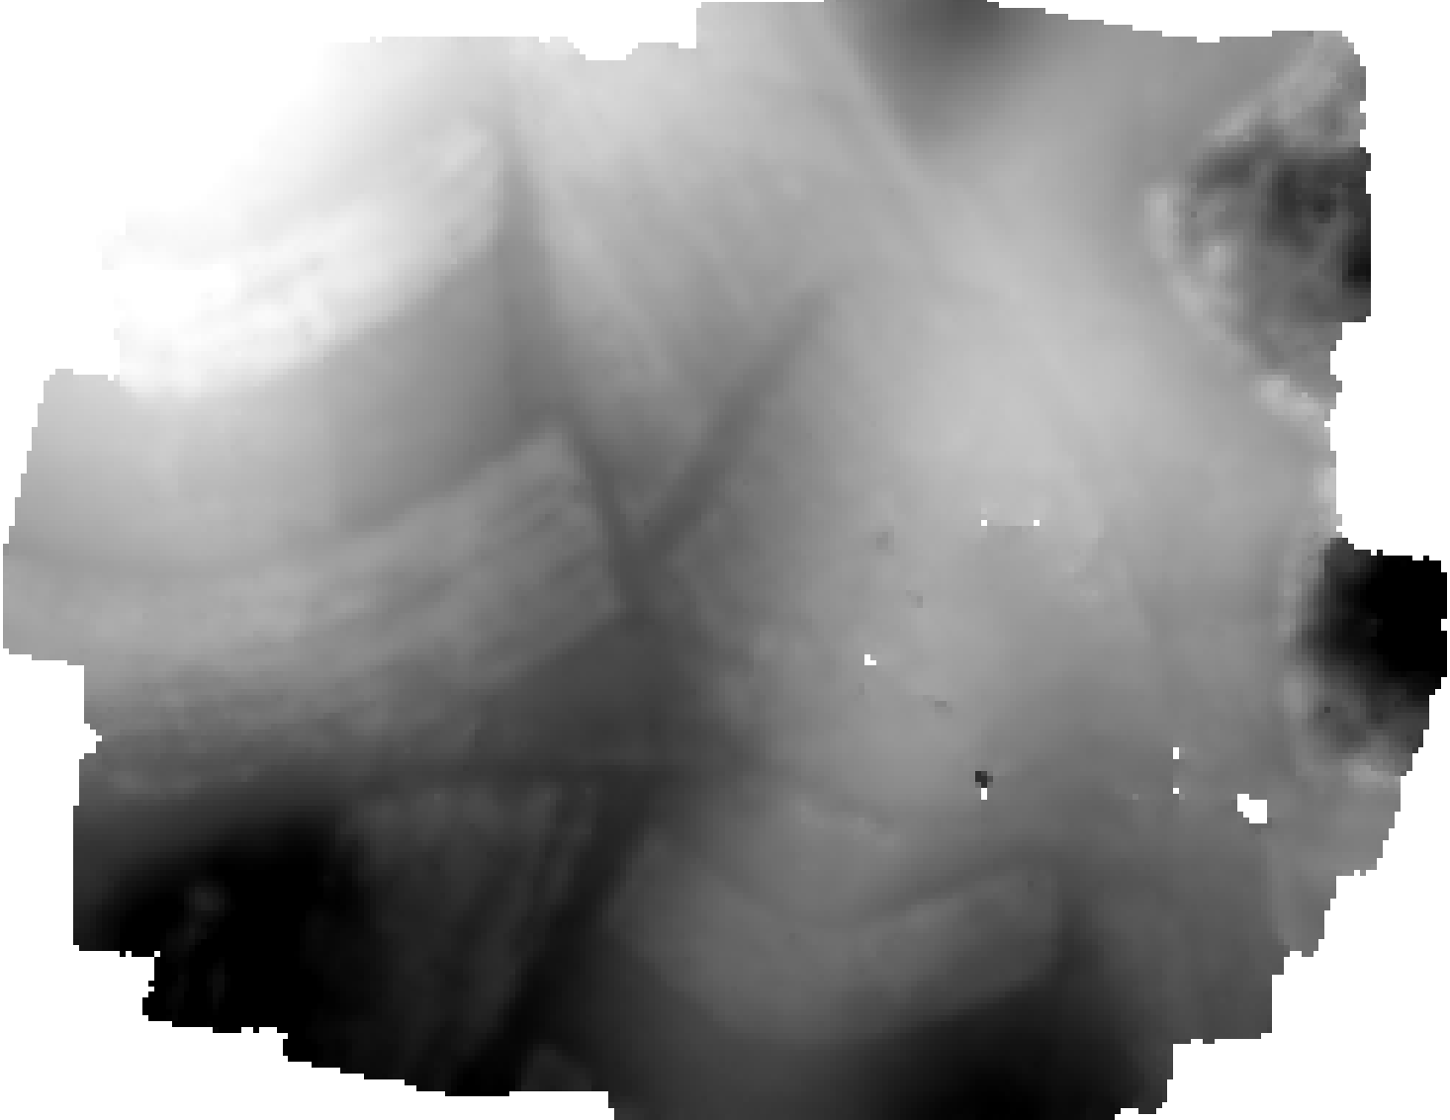
Midpines, flown by NextGen Air Transportation Center (NGAT) access to the data through collaboration with Center for Geospatial Analytics at NCSU

Slide 97
Near-term improvements
Quality reporting and robustness improvements
Incremental optimizations
Large-scale pipeline

Slide 98
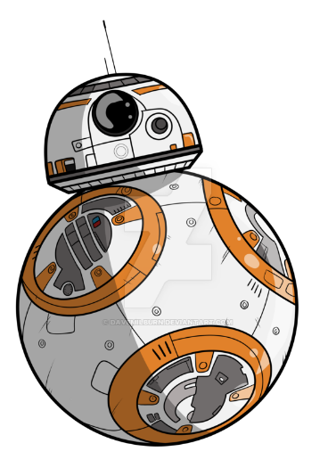
Quality reporting and robotness improvements
Add reporting system to OpenSfM
Collect metadata on Structure from Motion Process
Number of matches, Matching graph between images, Number of reconstructed images and points, Histogram of reprojection errors, Memory Usage, etc.
Improve Robotness
Analyze and classify failures
Improve results on difficult datasets
Establish test datasets for ongoing testing
http://davemilburn.deviantart.com/art/BB8-586862785

Slide 99

Large-scale pipelineor breaking datasets into bite-size pieces
Split large numbers of images into smaller groups
Run OpenSfM reconstruction on each subgroup
Align and transform those groups to each other using matching features between the groups

Slide 100



Large-scale pipelineor breaking datasets into bite-size pieces

Slide 101

Incremental optimizations or what happens after it’s down the gullet
Improve processor use
Cascade Hashing¹ matching
or
Bag of Words²
Improved Memory Use:
Improved correspondence graph data structures
SLAM-like pose-graph methods for global adjustment of camera position
[1] Jian Cheng, Cong Leng, Jiaxiang Wu, Hainan Cui, Hanqing Lu; The IEEE Conference on Computer Vision and Pattern Recognition (CVPR), 2014, pp. 1-8
[2] Michal Havlena, Konrad Schindler; VocMatch: Efficient Multiview Correspondence for Structure from Motion; Institute of Geodesy and Photogrammetry, ETH Zurich, Switzerland

Slide 102
WebODM: Future
DEM display
Volumetric Measurements
Mission Planning
Mobile App for autonomous flight
QGIS integration
Integration with Entwine + Greyhound
Integration with OpenAerialMap

Slide 103
With Great Data comes Great Responsibility
Ways to serve large datasets:
Point Clouds
Greyhound / PDAL / Entwine / Speck.ly
Meshes
Melown
GeoTiff
Tiles generated from GDAL

Slide 104
Questions

Slide 106
Using OpenDroneMap
Through WebODM

Slide 107
Test Dataset: https://we.tl/Kv2AagNmwt

Slide 108
Flight Planning

Slide 109
Automatic image capture along grids, lines, polygons,… with (DJI) drones
UgCS
Pix4Dcapture
Altizure
DroneDeploy
Aerobotics
SkyDrones
PrecisionFlight
Etc. etc.
Notes:
UgCS (desktop + app), flexible, but not intuitive)
Pix4Dcapture (“free” account)
Altizure (payed service)
DroneDeploy (“free” account)
Aerobotics (payed account)
SkyDrones (“free”)
PrecisionFlight
Etc. etc.

Slide 110

Pix4Dcapture

Slide 111

Pix4Dcapture

Slide 112

Pix4Dcapture

Slide 113

UgCS Desktop

Slide 114

UgCS Desktop

Slide 115
Free and Open Source
Mission Planner
QGroundControl
Tower

Slide 116

Mission Planner

Slide 117

QGroundControl

Slide 118

Tower

Slide 119

Sensefly
eMotion 2
eMotion 3

Slide 120


Flight Planning Rules for Good Data
60%+ overlap and sidelap
Fly camera 10-degrees off nadir
Fly at 4x height of tallest object (when possible)
Fly a Cross grid

